Slide 1
Dissecting VOD Services for Cellular : Performance , Root Causes and Best Practices
刘志磊
liuzhilei@iie.ac.cn
中科院信息工程研究所

Slide 2
What’s to measure?
QOE quality of experience
HTTP Adaptive Streaming (HAS)
A protocol proposed to adapt the video bitrate based on network condition
videos ——> multiple tracks having the same content
ie:
HTTP Live Streaming (HLS)
Dynamic Adaptive Streaming (DASH)
Smooth Streaming (SS)
Focus on Services on Android platforms

Slide 3
Summarize some Findings
• To improve quality , some apps perform Segment Replacement (SR)
• Some Services use Variable Bitrate (VBR) encoding
• Players wait a minimum number of seconds before playback
• Inadequate sync between multiple TCP connections and downloads lead to stalls
• A suboptimal buffer-based downloads strategy

Slide 4
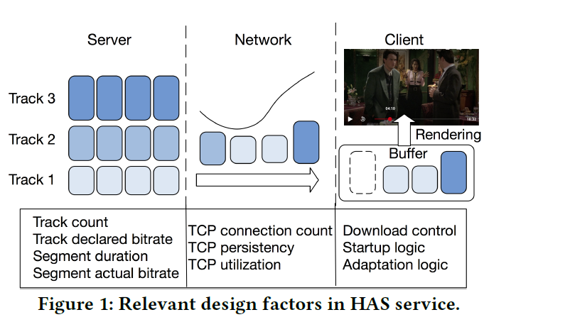
HAS Overview
Encoded into multiple tracks
Manifest or playlist
available tracks , segment duration , URIs , declared bitrate
Declared bitrate
an estimation of network bandwidth required to stream the track
Actual segment bitrate
average actual segment bitrate

Slide 5
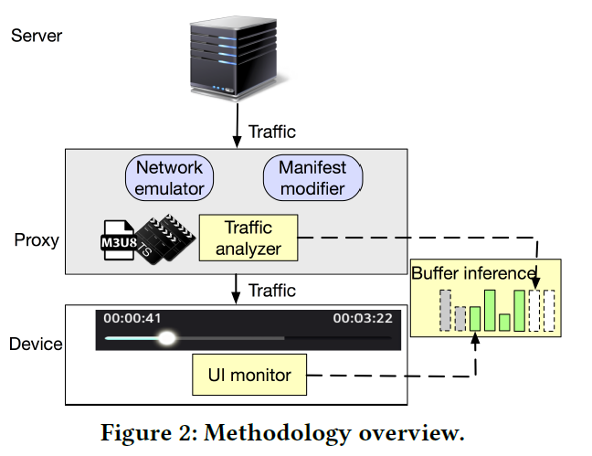
Methodology overview
Proxy
emulate various network conditions and extract video segments info from traffic flow
Network emulator
Manifest modifier
Traffic analyzer
Device
UI monitor
Device-Proxy
Buffer inference

Slide 6
Tips
namespace
We observe thar all the studied apps adopted one or more among the three popular HAS techniques
i.e. HLS , DASH , Smoooth Streaming
DASH D1~D4
HLS H1~H6
SS S1~S2

Slide 7
METHODOLOGY
Methodology

Slide 8
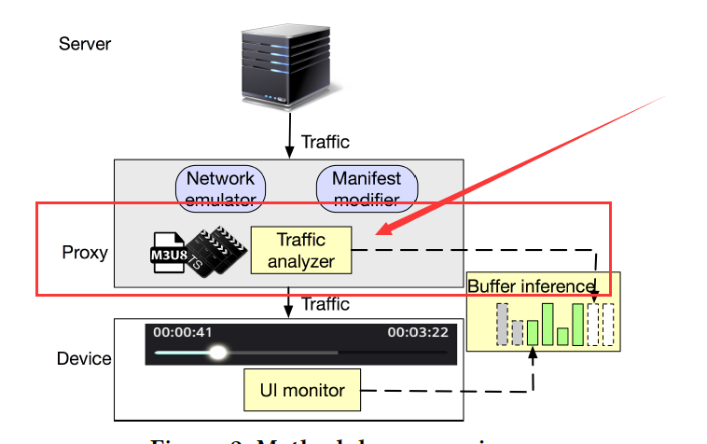
Methodology && Traffic analyzer
Traffic analyzer
Man-in-the-middle
Extracts manifest and segment information from flows between server and client
Build mappings between http requests and segments
Work with the most popular potocal implementations
HLS and DASH

Slide 9
Methodology && Traffic analyzer
HLS
Media presentation is described by a Master Playlist
For HLS , it gets the birtate of each track from the Master Playlist
DASH
media content is described by the Media Presentation Description(MPD)
Segment Index Box(sidx)
for Dash , it gets the bitrate from the MPD , and generates the mapping of byte ranges to segment information using different data sources of different apps.
D2 , D3 , D4 put such information into the sidx
while D1 directly encodes it in the MPD.

Slide 10
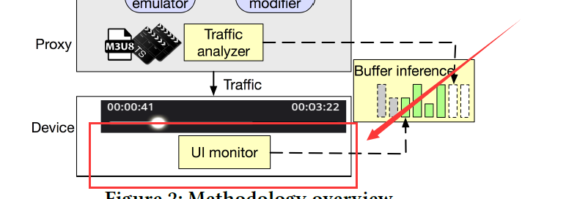
Methodology && UI monitor
UI monitor
Exposing QoE metrics
Aims at exposing QoE metrics that can be obtained from the app UI on the client
Seekbar is a commonly used UI element that indicates the playing progress
How to robustly capture the seekbar information
Xposed —— an android framework which enables hooking android system calls without modifying apps , to log system calls from the apps to update the seekbar
Android API: ProgressBar.setProgress
obtain information about playback progress and stall events from the API calls

Slide 11
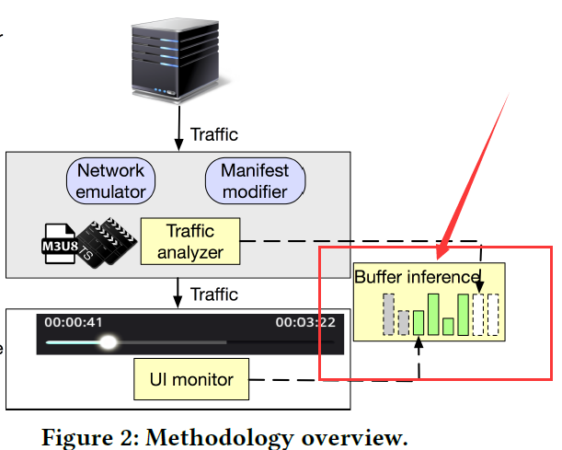
Methodology && Buffer inference
Buffer inference
Buffer status
Buffer occupancy —— crucial for characterizing the player’s behavior
Infer buffer occupancy
combining info from the downloading process and the playback process , collected by the traffic analyzer and UI monitor

Slide 12
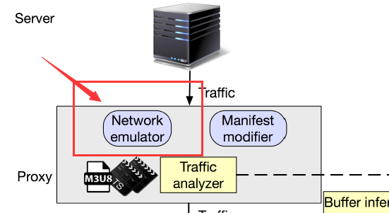
Methodology && Network emulator
Network emulator
Linux tool tc
Control the available network bandwidth to the device across time to emulate various network conditions
To understand adaptation logic
carefully designed network bandwidth profile
to collect real world bandwidth traces , we download a large file over
the cellular network and record throughput every second . We collect 14
bandwidth traces from real cellular network in various scenarios covering
different movements patterns , signal strength and locations . We sort them
Based on their average bandwidth and denote them from Profile 1 to
Profile 14 .

Slide 13
SERVICE CHARACTERIZATION
Service Characterization

Slide 14
SERVICE CHARACTERIZATION && Server Design
Server Design
Analyze the first 9 videos on the landing page.
Separate audio track
server can either encode separate audio tracks or multiples video and audio content
we find that all the studied services that use HLS do not have separate audio tracks , while all services that use DASH or Smooth Streaming encode separate audio tracks
Track bitrate setting
number of tracks , highest and lowest tracks , spacing between consecutive tracks all impact QoE
the bitrate of the lowest track impacts players’ ability to sustain seamless playback under poor network , suggest setting the bitrate reasonably low for mobile network
tracks between the highest and the lowest track need to be selectled with proper inter-track spacing

Slide 15
Server Design
CBR Encdointg
encodes all segments into similar bitrates
VBR Encoding
which can encode segments with different bitrates based on scene complexity
Segment duration
from 2s to as long as to 10s

Slide 16
SERVICE CHARACTERIZATION && Transport layer design
Transport layer design
TCP connection count and persistence
all studied apps use HLS use a single TCP connection to download segments , 3 of these apps use no-persistent connection
Suggest use persistence connection
TCP connection utilization
multiple connections and concurrent download D1
download one each time D3
split to multiple sub segments and schedules them on different connections

Slide 17
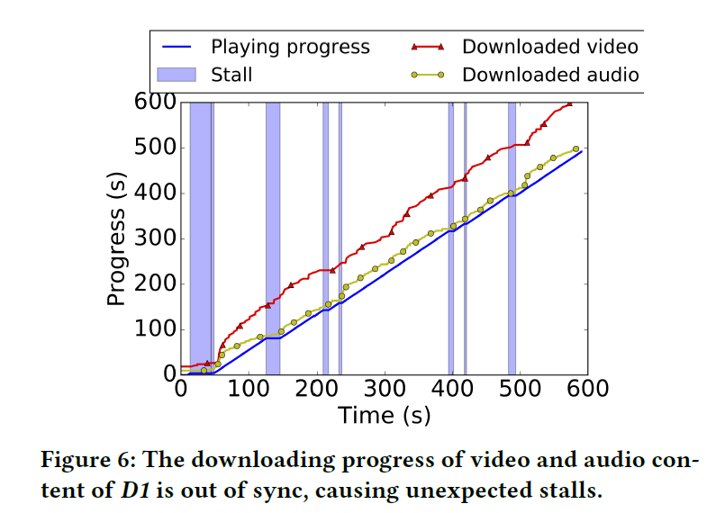
SERVICE CHARACTERIZATION && Transport layer design
TCP connection utilization
audio and video track are separate
there should be adequate synchronization across the two download process to ensure
that both contents are available by the designated playback time of the segment
D1
For the two network profiles with the lowest average bandwidth , the average difference between video and audio downloading progress is 69.9s and 52.5s respectively.

Slide 18
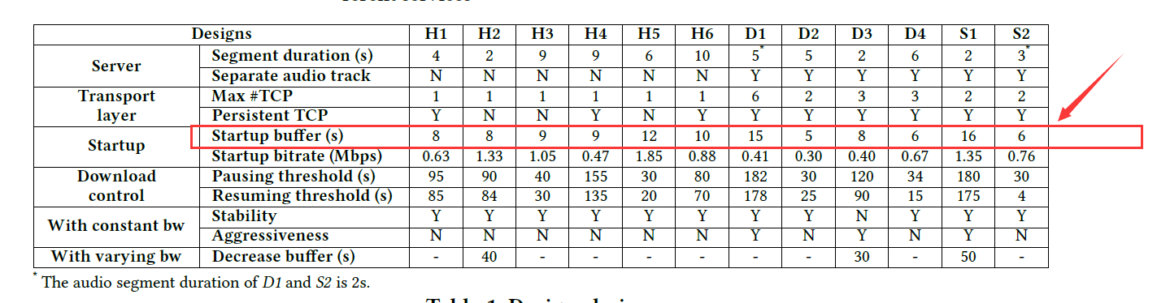
SERVICE CHARACTERIZATION && Client-side design
Client-side design – startup logic
Startup duration
at the beginning of a session , client need to download a few segments before starting playback
instrument the proxy to reject all segment requests after the first n segments ,we gradually increase n and find the minimal n required for player to start playback.

Slide 19
SERVICE CHARACTERIZATION && Client-side design
Startup track
select the first segment to download while don’t know the condition of network bandwidth.
we find each app consistently selects the same track level across different runs.
the startup bitrates across apps have high diversity . 4 apps start with a bitrate lower than 500kbps , while another 4 apps higher than 1Mbps.

Slide 20
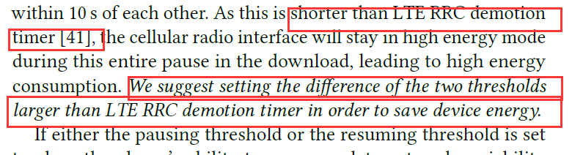
SERVICE CHARACTERIZATION && Client-side design
Download Control
when to download the next segment. A navie strategy is to keep fetching but may waste data when users abort the session
pausing threshold —— pause download when buffer occupancy increases to it
resuming threshold —— resums downloads when buffer occupancy drops below it
The time between them determines the network interface idle-duration

Slide 21
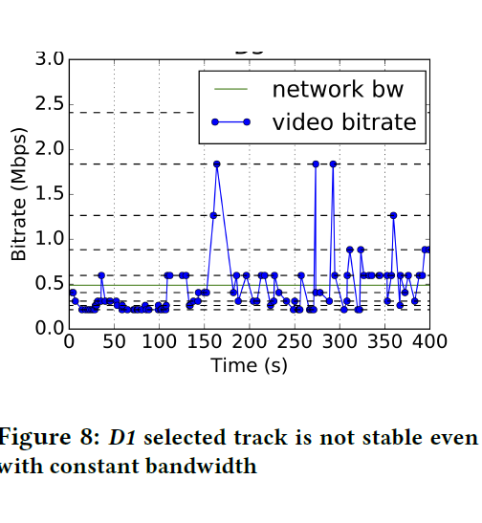
SERVICE CHARACTERIZATION && Client-side design
Track selection under stable network bandwidth
Stability
D1 does not stabilize even with constant network bandwidth
we suggest the adaptation logic avoid unnecessary track switches

Slide 22
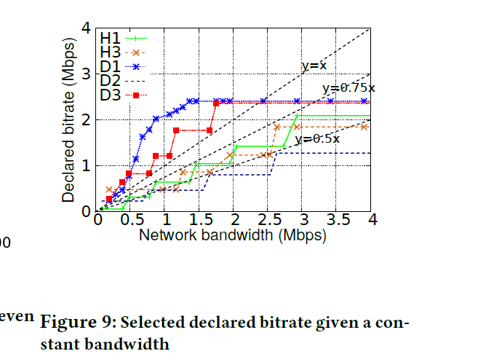
Client-side design && track selection under stable network bandwidth
Aggressiveness
We term services that converge to a track with declared bandwidth closer to available bandwidth as more aggressive. We show a few examples in Figure 9. We find 3 apps are more aggressive and select tracks with bitrate no less than the available network bandwidth. The reason why they are able to stream tracks with a bitrate higher than available network bandwidth
without stalls is that they use VBR encoding and the actual segment bitrate is much lower than the declared bitrate.

Slide 23
SERVICE CHARACTERIZATION && Client-side design
Track adaption with varying network bandwidths
Reaction to bandwidth increase
when bandwidths increase , all apps start to switch to a track with higher bitrate after a Few segments . In addition some apps revisit earlier tracks switching decisions and redownload existing segments
Reaction to bandwidth decrease
a higher buffer pausing threshold enables more buffer buildup , which can help apps better absorb bandwidth changing events and defer the decision to select a lower track without the danger of stalls

Slide 24
QOE ISSUES: DEEP DIVE
QOE ISSUES: DEEP DIVE

Slide 25
QOE ISSUES: DEEP DIVE && SR
Segment Replacement (SR)
When the network condition turns to be better , some players will discard low quality segments in buffer and not be played , and redownload these segments using a higher quality track
Usage and QoE impact of SR for popular VOD apps
H4 perform SR
when SR occurs , only the last downloaded segment that have the same index is preserved
Reaction to bandwidth increase
increase data usage
even degrade video quality . The redownloaded segments are not always high quality

Slide 26
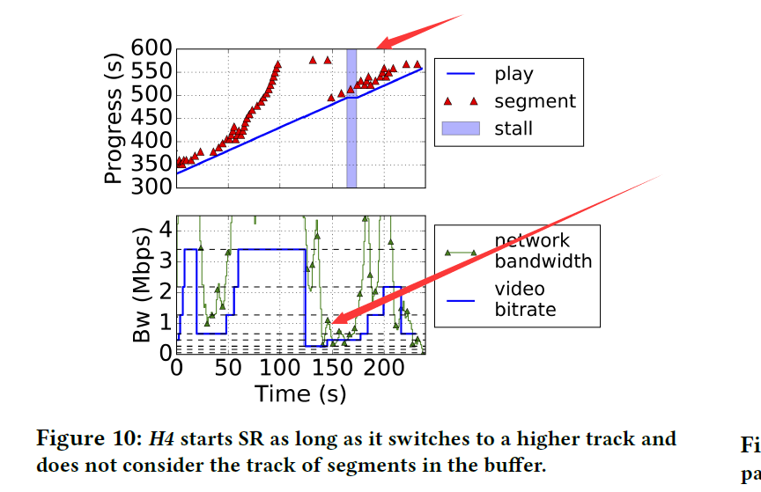
QOE ISSUES: DEEP DIVE && SR
How SR is performed
we find that after H4 redownloads a segment seg , it always redownloads all segments that are in the buffer with indexes higher than seg
when SR occurs , only the last downloaded segment is preserved
When SR is triggered
we find in 22.5% of SR cases , even the first redownloaded segment had lower or eaual quality compared with the on already in the buffer . This implies that H4 may not properly consider the video quality of buffered segments when performing SR.
We show an example of H4 performing SR in Figure 10. At 150 s,
H4 switches from Track 3 to Track 4, which triggers SR. Instead
of downloading the segment corresponding to 580 s’ of content, it
goes back to redownload the segment corresponding to 500 s’ of
content. In fact, that segment was already downloaded at 85 s with
a higher quality from Track 8.

Slide 27
QOE ISSUES: DEEP DIVE && SR
SR analysis with ExoPlayer
it can also redownload segments with lower or equal quality.
When it decides to select a higher track X than the last selected one Y,
It initiates SR if the buffer occupancy is above a threshold value.
t identifies the segment with the smallest playback index in the bufer that is from a track lower than the track Y that ExoPlayer is about to select for the upcoming download.
What cause this ?
data structure design —— double-ended queue
Network activities put new segments on one end, while the
video renderer consumes segments on the other end, which ensures
that the memory can be efficiently recycled. Discarding a segment
in the middle is not supported, and thus to perform SR, the player
has to discard and redownload all segments with higher indexes
than the first chosen one.

Slide 28
QOE ISSUES: DEEP DIVE && SR
SR Best practices and improvement evaluation
As an example, when segments are discarded from the buffer, their track information is recorded. Later if the track selection logic determines to redownloaded them with quality no higher than the discarded ones, we change the track selection to select the track of the discarded segment so that they can be recovered directly from the local cache on the device without sending traffic to the network.
To evaluate the QoE impact of the improved SR algorithm, we
play a publicly available DASH stream [7] using the 14 collected
real world bandwidth profiles. We find that, across the profiles, the
median and 90th percentile improvements in average bitrate are
11.6% and 20.9% respectively.

Slide 29
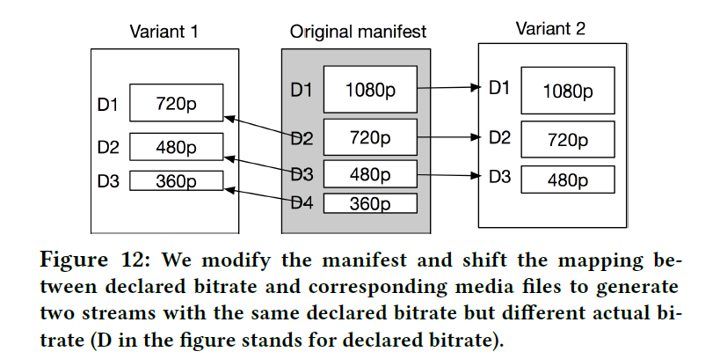
QOE ISSUES: DEEP DIVE && Declared vs Actual Bitrate
Using Declared vs. Actual Bitrate
we find that the adaptation logic in some players such as D2 relies purely on the declared bitrate to make track selection decisions, leading to suboptimal QoE.
comparing these two variants, each track in variant 1 has the same declared bitrate as the track of the same level in variant 2, but the actual bitrate is the same as that of the next lower track in variant 2.
This suggests that it only considers the declared bitrate in its decision on which track to select next, else the player would select tracks with different levels for the two variants but with the same actual bitrate.

Slide 30
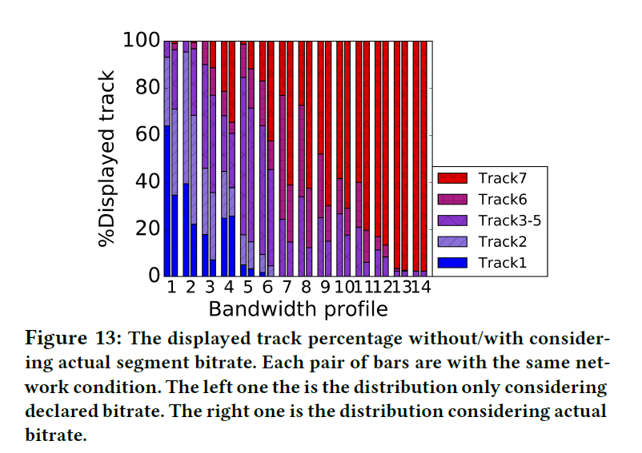
QOE ISSUES: DEEP DIVE && Declared vs Actual Bitrate
Consider the actual bitrate
To evaluate the performance, we VBR-encode the Sintel test video [14]
and create an HLS stream consisting of 7 tracks. For each track we set the peak bitrate (and therefore the declared bitrate) to be twice of the average bitrate . We play the video both with the default adaptation algorithm and the modified algorithm that considers actual bitrate using the 14 collected network profiles.
Across the 14 network profiles the median of average bitrate improvements is 10.22%.

Slide 31
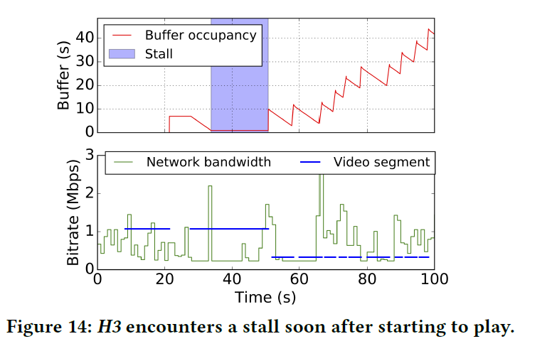
QOE ISSUES: DEEP DIVE && improving startup logic
Improving Startup Logic
We find that some apps such as H3 always have stalls at the beginning of playback with certain network bandwidth profiles,
in Figure 14, H3 first selects the track with a bitrate around 1 Mbps,
which is higher than the available network bandwidth . It starts
playback after downloading the first segment. For the second segment it keeps selecting the same track as it may not yet have built up enough information about the actual network condition. As the network bandwidth is lower than selected bitrate, the buffer goes empty before the second segment is downloaded, leading to a stall.

Slide 32
QOE ISSUES: DEEP DIVE && improving startup logic
Findings
We find H3 and H2 set similar startup buffer durations.
However, H2 does not encounter stalls with the same network,
while H3 does. Further analysis shows that each segment of H2 is
only 2 s long and it downloads 4 segments before starting playback,
while the segment duration for H3 is 9 s and it starts playback once
a single segment is downloaded.
Based on this observation, we hypothesize that the likelihood of having stalls at the beginning of playback does not only depend on the startup buffer duration in seconds but also on the number of segments in the buffer. Using
just 1 segment as startup buffer introduces a high possibility to have stalls at the beginning of playback.

Slide 33
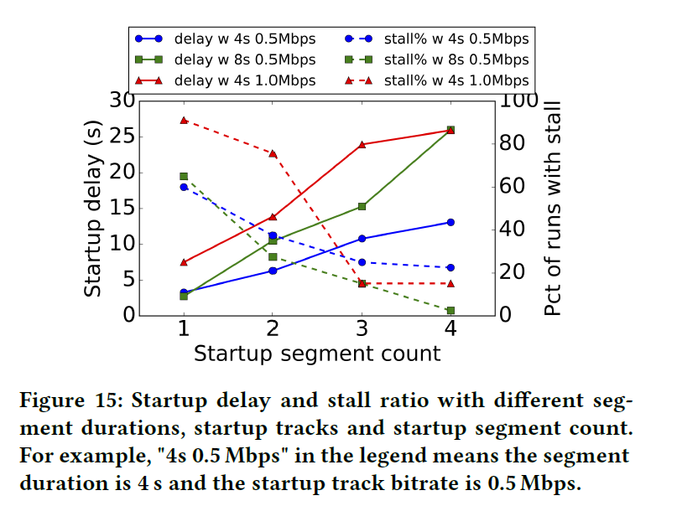
QOE ISSUES: DEEP DIVE && improving startup logic
• The stall ratio depends on both the startup buffer duration and the segment duration. With the same startup buffer duration of 8 s, the stall ratio with segments of 4 s is only 57.7% of the ratio with segments of 8 s.
• Compared with using 1 segment as startup buffer, using 2 or 3 segments significantly reduces the stall possibility. In all video settings, the stall ratio for using 3 segments is less than 41.7% of the stall ratio for 1 segment.
• Using a higher bitrate track as startup track can significantly increase stall possibility, especially when startup buffer is only 1 segment. With the startup buffer duration set to be 4s, when increasing the startup track bitrate from 0.5Mpbs to 1Mbps, the stall ratio increases from 60.0% to 91.1%.

Slide 34
THE END
刘志磊
liuzhilei@iie.ac.cn
中科院信息工程研究所

